Slide 1
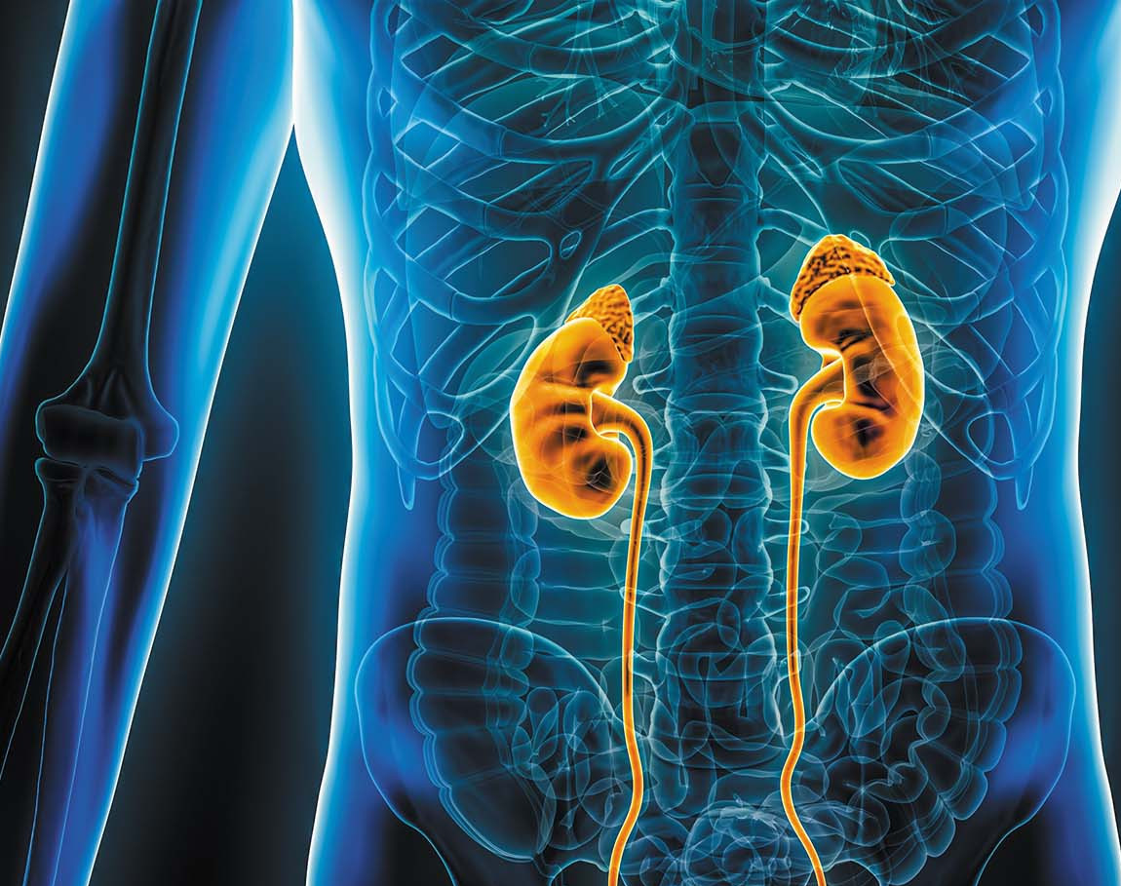
Week 7
GU & Renal

Slide 2

Kidney & GU Basics
Review of Anatomy & Physiology
RAAS

Slide 3
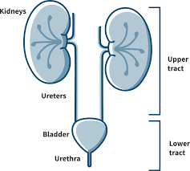

Slide 4
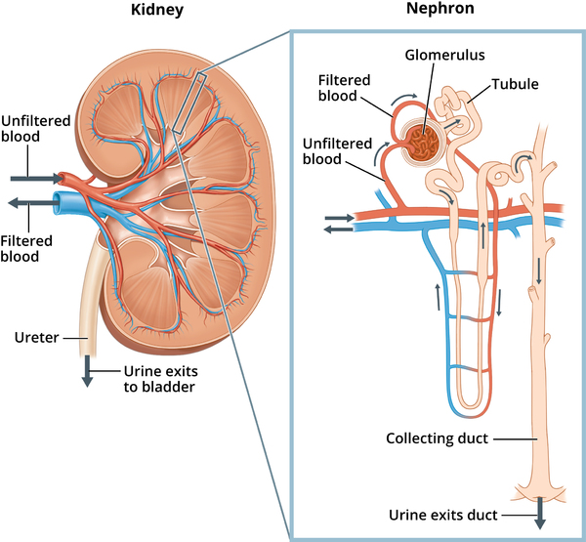
Renal pelvis
Bowman’s capsule
Proximal Convoluted
Electrolytes
Renin made here
Distal Convoluted Tubule
ADH/aldosterone act here
Renal calyx
Loop of Henle
Water, Na, urea, Cl

Slide 5
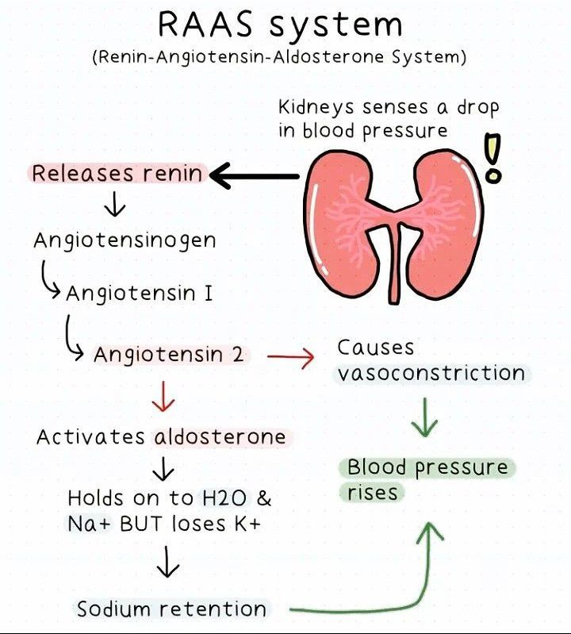

Slide 6
Urinalysis (UA) Components
Appearance
Blood
Ketones
Bacteria
Glucose
Specific Gravity

Slide 7
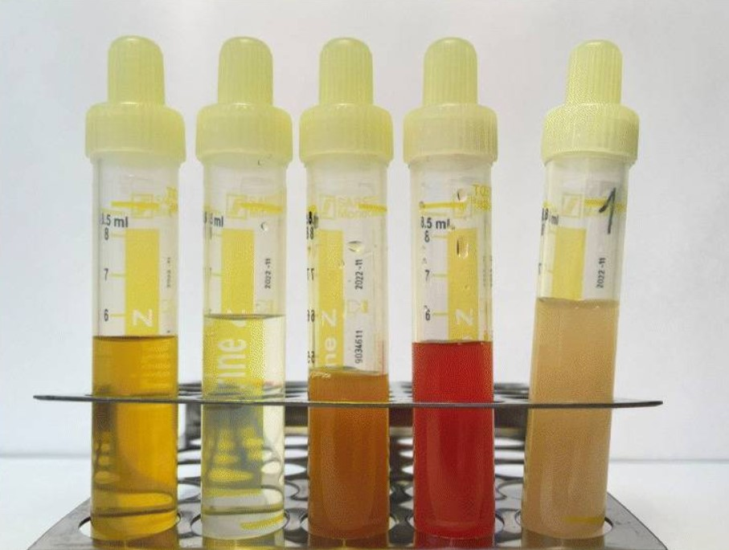
Yummy

Slide 8
Urinary Tract Infection
Cystitis
Pyelonephritis

Slide 9
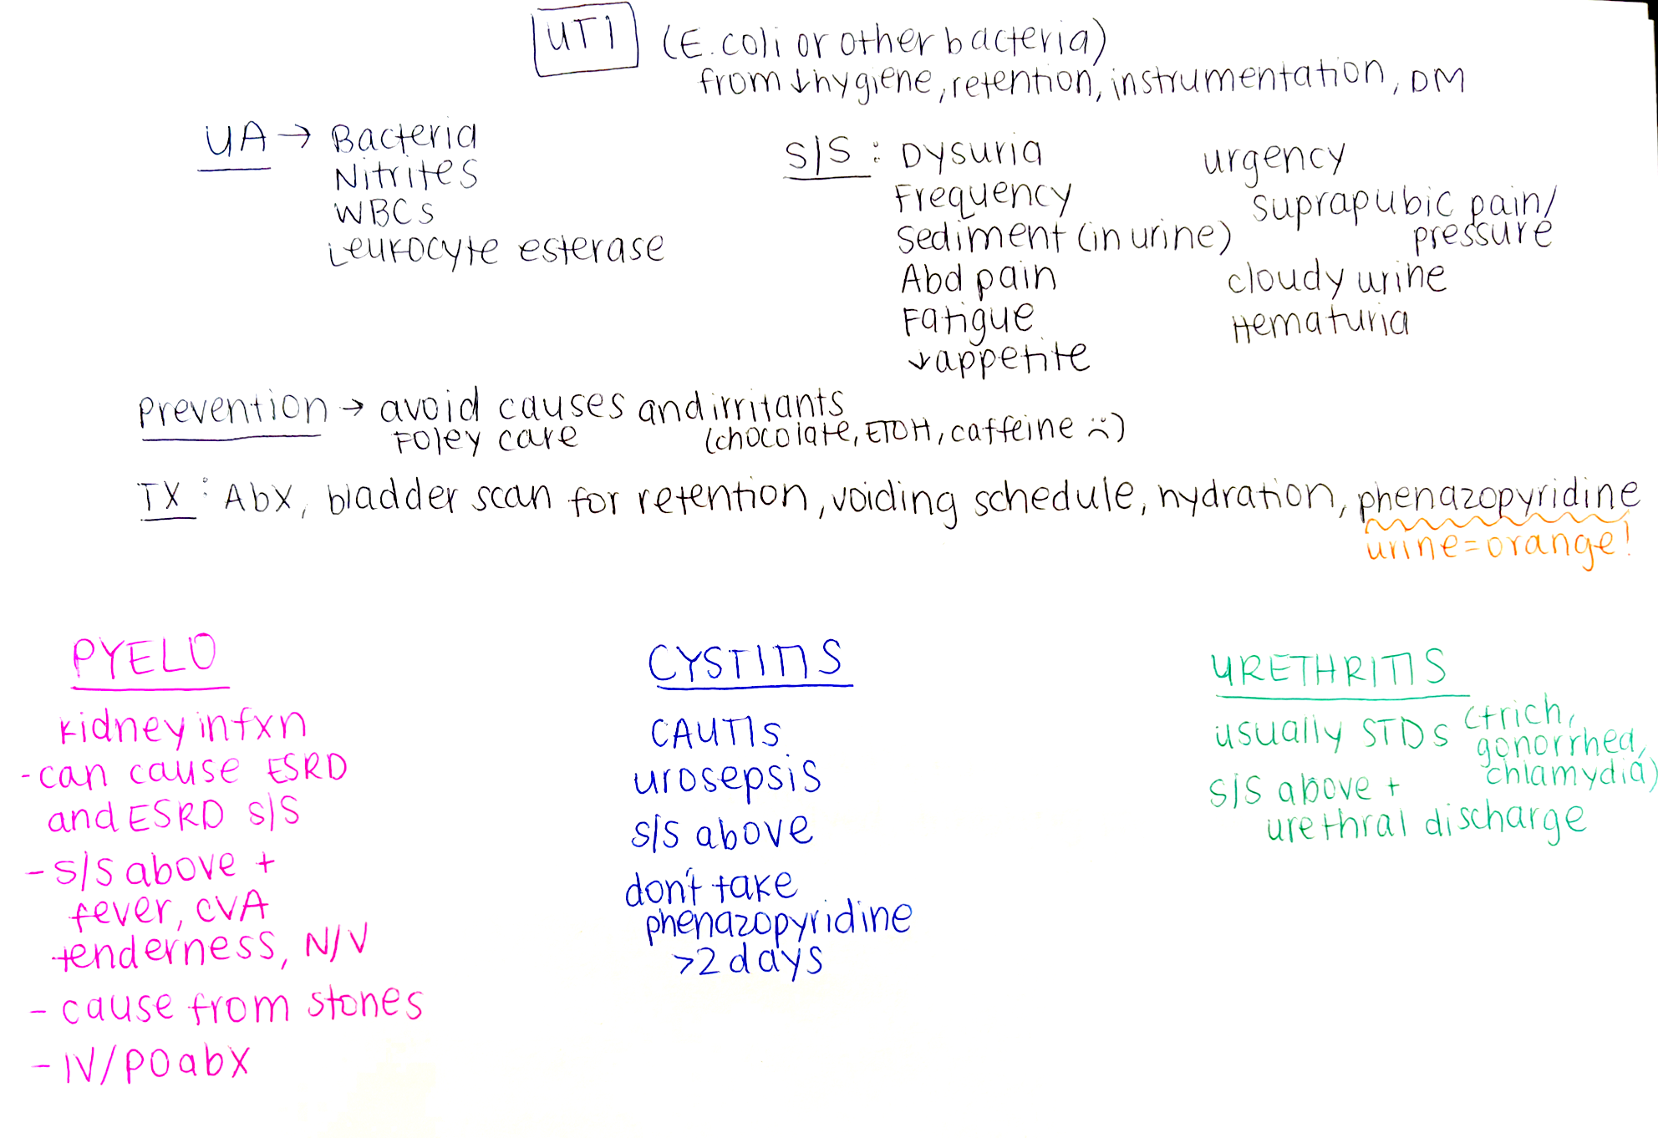

Slide 10
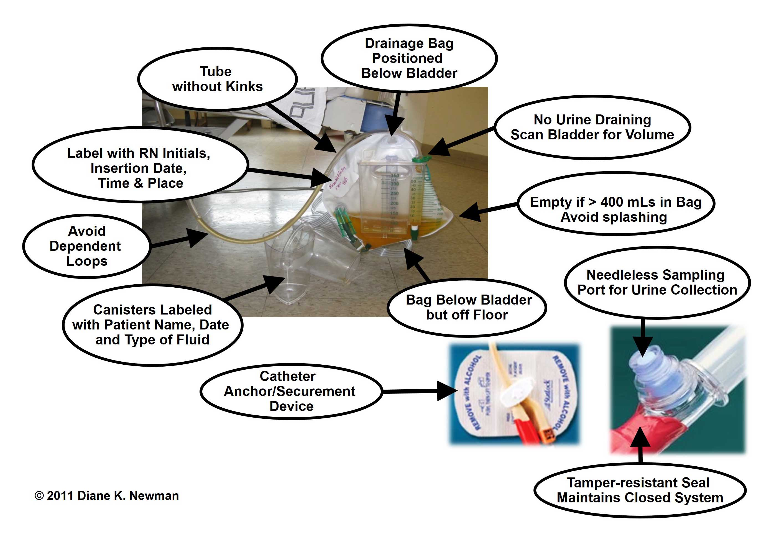
CAUTI Prevention

Slide 11
The nurse is teaching a client with recurrent cystitis about preventing UTIs. Which client statement needs correction?
“I will drink 2-3 liters of water every day.”
“I will limit my water intake in the evening.”
“I will drink cranberry juice daily with breakfast.”
“I will add a tablespoon of apple cider vinegar to one glass of water each day.”
Notes:
B

Slide 12
What should the nurse teach a young woman with a history of UTIs about UTI prevention? Select all that apply.
Maintain regular bowel elimination
Limit water intake to 1-2 glasses a day
Wear cotton underwear
Cleanse the perineum from front to back
Practice pelvic muscle exercises (Kegel) daily
Notes:
A, C, D

Slide 13
Which patient is most at risk for developing a UTI?
  50yo male with kidney stone
  32yo pregnant female that takes a bath daily
  68yo male with immobility
  45yo female with diabetes mellitus
Notes:
B – has the most risk factors (pregnant, female, daily bath)

Slide 14
What signs and symptoms are most likely present in a patient with a UTI? Select all that apply.
  Dysuria
  Increased frequency of urination
  Clear and odorless urine
  Nocturia
  Upper abdominal pain
Notes:
A, B, D

Slide 15
The nurse assesses a client reporting urinary frequency and burning. To determine whether the problem is of renal origin, the nurse assesses for pain in which location?
Right lower quadrant
Epigastric area
Suprapubic area
Costovertebral angle
Notes:
D

Slide 16
A nurse is educating patients on preventing UTIs. What should the nurse include?
Soak in a bubble bath weekly
Wipe perineal area from back to front
Limit water intake during the day
Empty the bladder before and after sexual intercourse
Notes:
D

Slide 17
Nephritic vs Nephrotic Syndrome
Glomerulonephritis
Nephrotic Syndrome

Slide 18
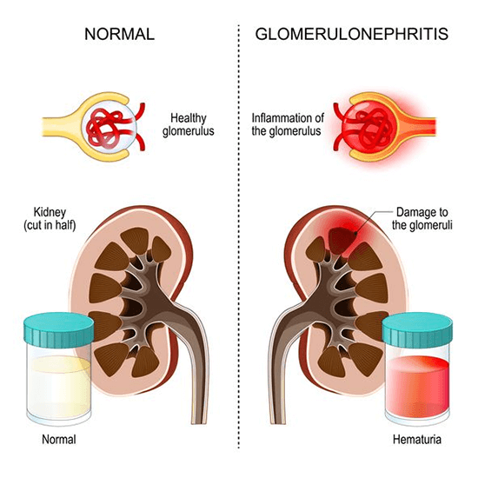

Slide 19
Let’s Make A Table ☺

Slide 20
The nurse cares for a client with nephrotic syndrome. The nurse identifies which key feature of nephrotic syndrome when reviewing the client’s lab results?
Hyperalbuminemia
Hypolipidemia
Decreased coagulation
Proteinuria
Notes:
D

Slide 21
Urinary Obstructions
Kidney Stones (Nephrolithiasis)
Strictures

Slide 22
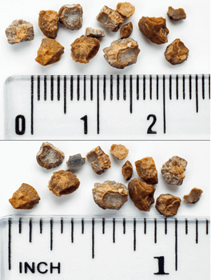
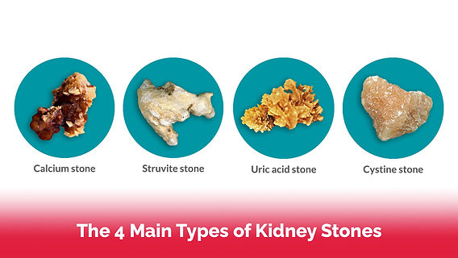

Slide 23
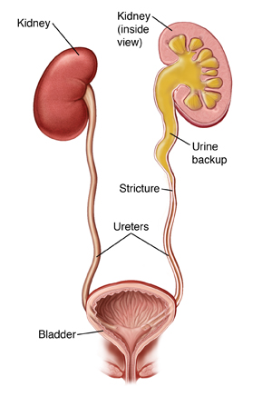
Ureteral Stricture
Hydronephrosis
Ureteral Stricture and Hydronephrosis

Slide 24
Urinary Incontinence vs Retention
Types of Incontinence
Neurogenic Bladder

Slide 25
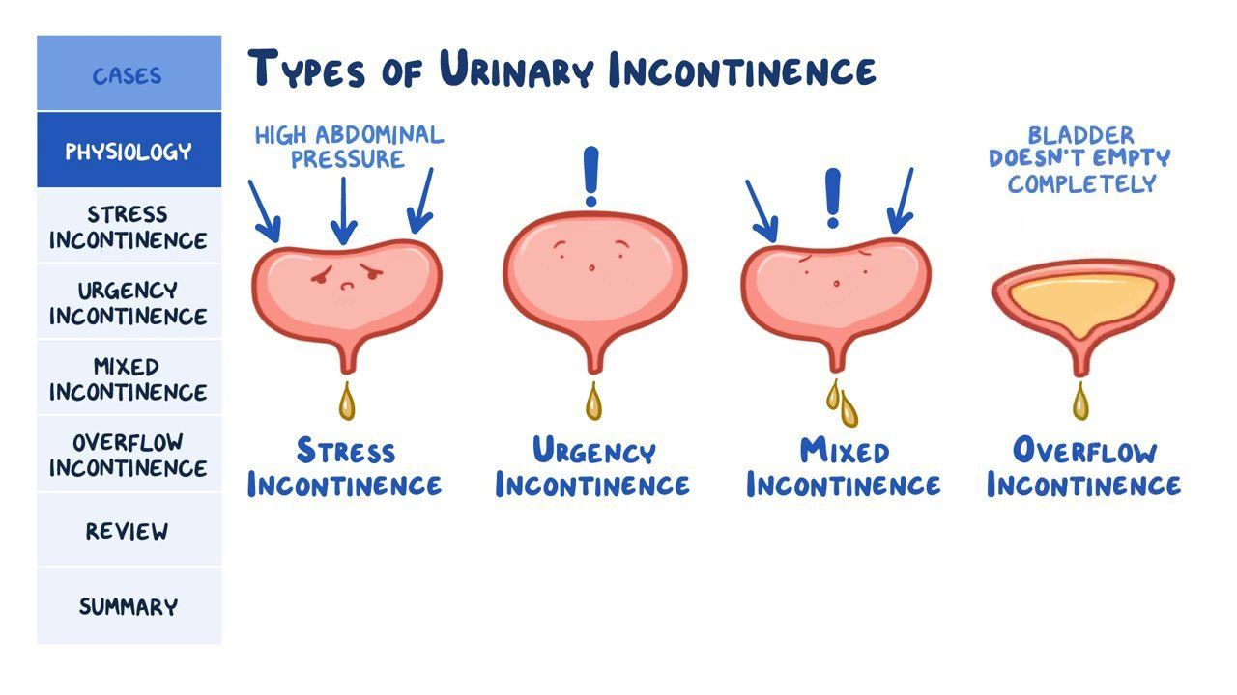

Slide 26
A patient reports a sudden need to urinate. Which type of incontinence should the nurse document this as?
Stress incontinence
Urge incontinence
Functional incontinence
Overflow incontinence
Notes:
B

Slide 27
What is the best word for the loss of voluntary control of the bladder?
Retention
Cholecystectomy
Pyelonephritis
Incontinence
Notes:
D

Slide 28
Which type of incontinence is present when increased intraabdominal pressure forces urine through the urinary sphincter?
  Urge incontinence
  Stress incontinence
  Overflow incontinence
  Functional incontinence
Notes:
B

Slide 29
Let’s Play a Game

Slide 30
Chronic Kidney Disease (CKD)

Slide 31
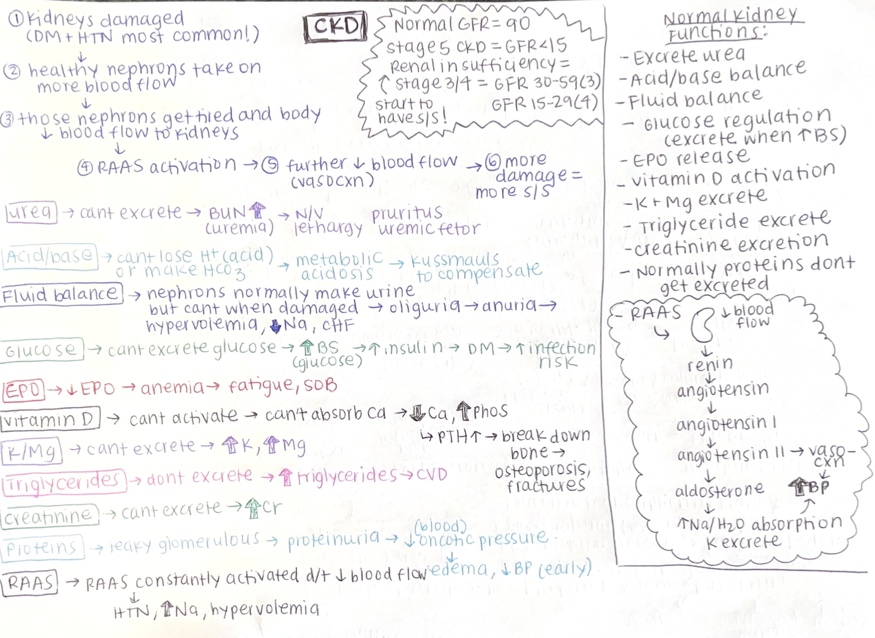

Slide 32
Which of the following electrolyte imbalances would be present in a patient with CKD? Select all that apply.
Hypokalemia
Hyponatremia
Hyperphosphatemia
Hypercalcemia
Notes:
B (could be high or low), C

Slide 33
Which of the following lab values would be expected in a patient with CKD? Select all that apply.
  Increased K
  Increased Hgb
  Decreased creatinine
  Increased Mg
  Increased GFR
Notes:
A, D

Slide 34
Which statement best describes the pathophysiology of CKD?
  CKD has a rapid onset after large ingestion of nephrotoxic medications
  CKD is most commonly from an irreversible AKI
  CKD results from prolonged stimulation of RAAS
  CKD has an insidious onset after prolonged nephron damage
Notes:
D

Slide 35
Acute Kidney Injury (AKI)

Slide 36
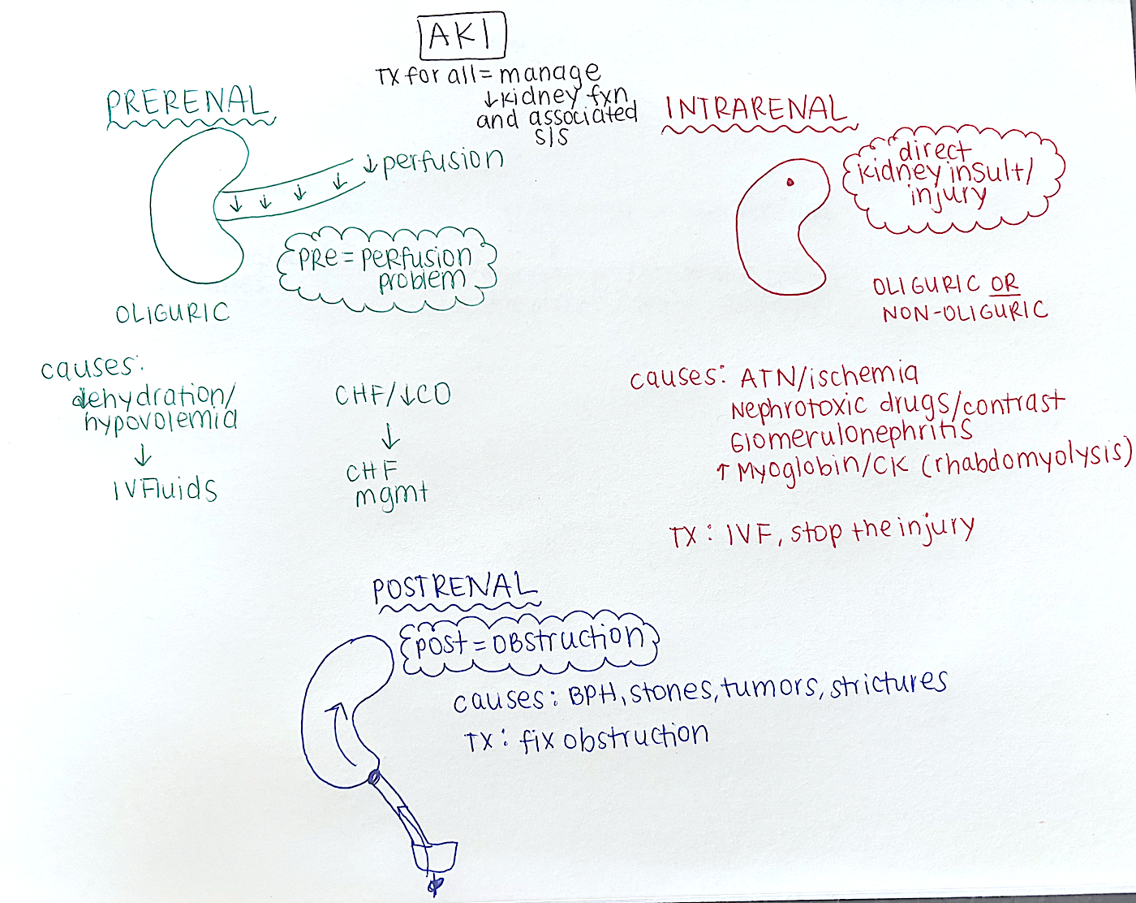

Slide 37
Kidney stones would cause which type of kidney injury?
Prerenal
Intrarenal
Postrenal
Epirenal
Notes:
C

Slide 38
What is a cause of acute renal failure?
Diabetes and hyperglycemia
Short-term, high dose of toxins
Hypertension and atherosclerosis
Long-term exposure to renal toxins
Notes:
B

Slide 39
Which of the following would be a potential cause of a prerenal AKI?
Glomerulonephritis
Kidney stone
Exposure to IV contrast
Hypovolemia
Notes:
D

Slide 40
A patient with benign prostatic hyperplasia (BPH) is at increased risk of developing which AKI?
Prerenal
Intrarenal
Postrenal
Both B & C
Notes:
C

Slide 41
Which of the following would cause an intrarenal AKI?
  Benign prostatic hyperplasia (BPH)
  Rhabdomyolysis
  Myocardial infarction
  Dehydration
Notes:
B

Slide 42
Which statement best describes the pathophysiology of postrenal AKIs?
  There is a lack of perfusion to the kidney
  Diabetes and hypertension damage the kidney acutely
  There is an obstruction in the urinary system that does not allow proper outflow of urine
  The kidney is injured from glomerulonephritis
Notes:
C

Slide 43
Dialysis
Hemodialysis
Peritoneal Dialysis

Slide 44
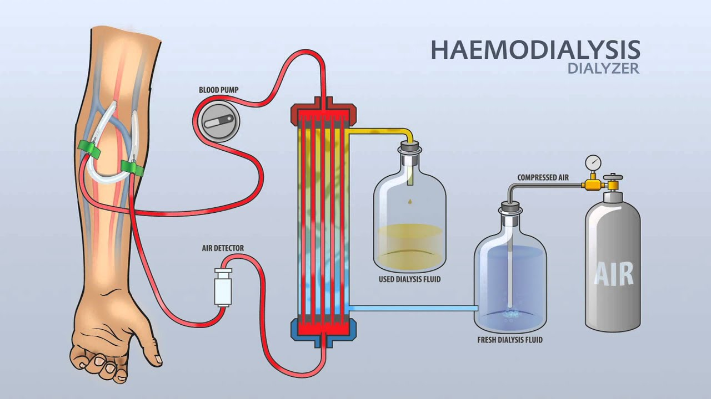

Slide 45
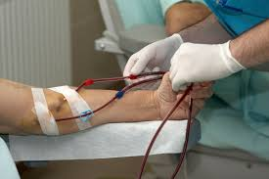
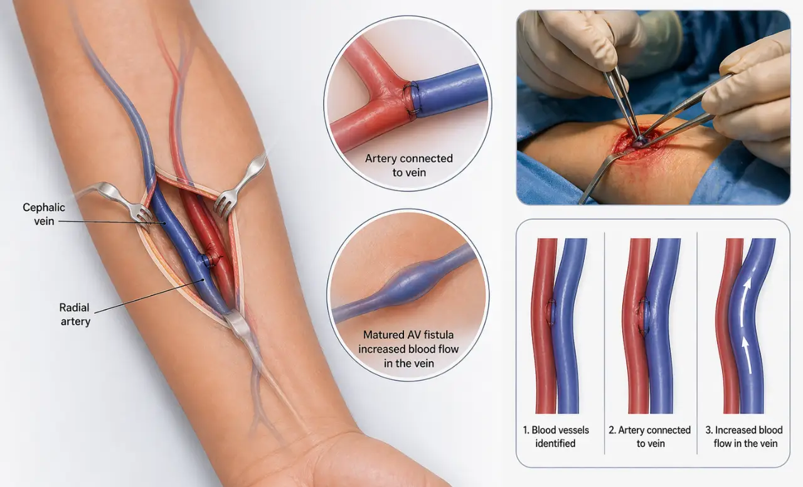

Slide 46
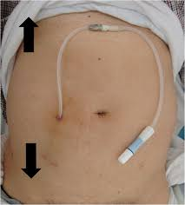
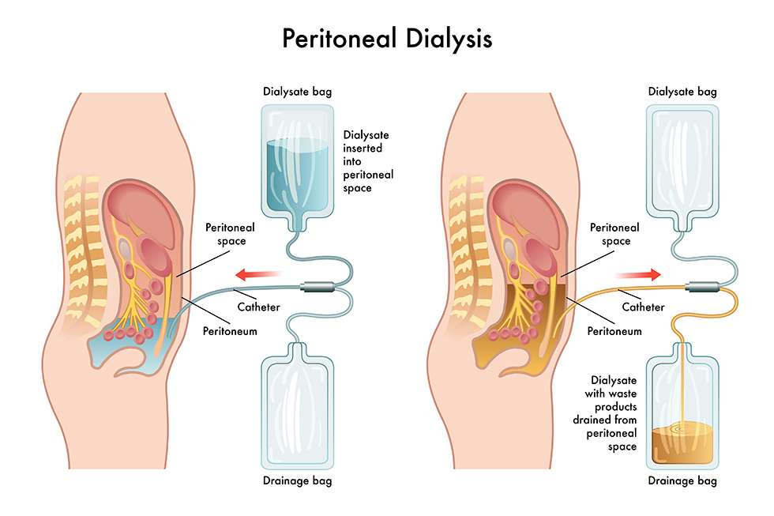

Slide 47
Which of the following is a potential complication of hemodialysis?
Peritonitis
Cloudy dialysate
Redness to abdomen
Thrombosis
Notes:
D

